Slide 1
Bootstrap Your Own Latent A New Approach to Self-Supervised Learning
Xiaoyu Li
2020.11.6

Slide 2
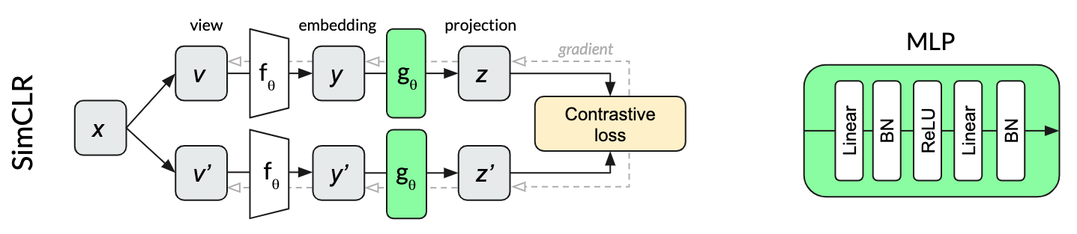
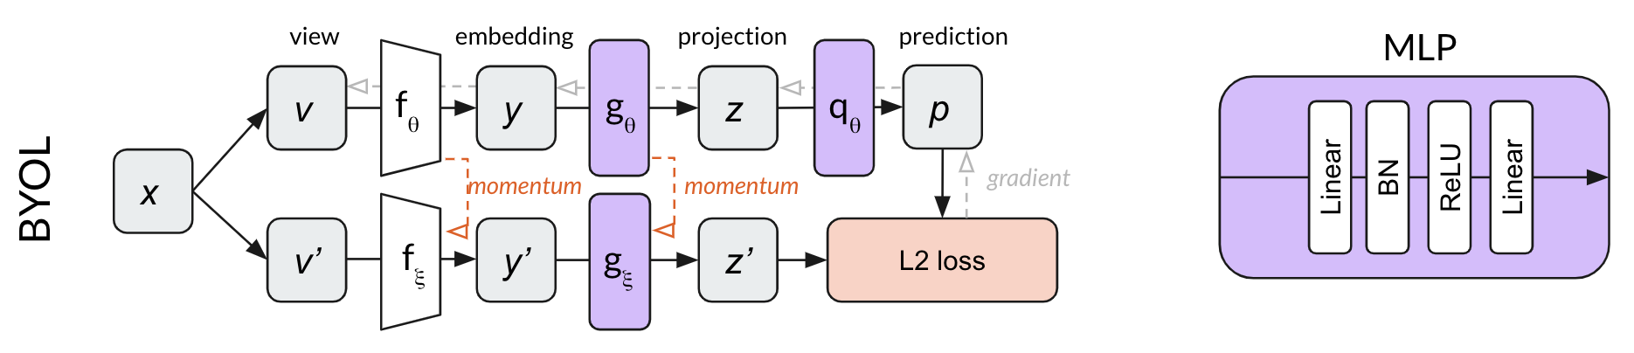
BYOL: Bootstrap Your Own Latent
https://arxiv.org/pdf/2006.07733.pdf
https://untitled-ai.github.io/understanding-self-supervised-contrastive-learning.html

Slide 3
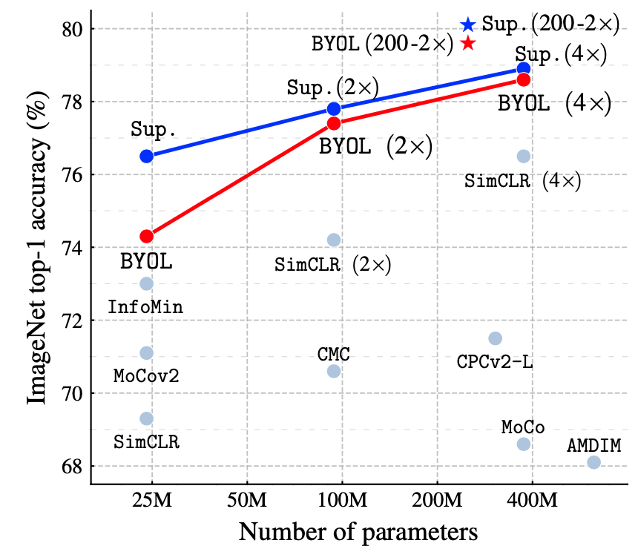
Overview
NIPS 2020 oral
DeepMind

Slide 4
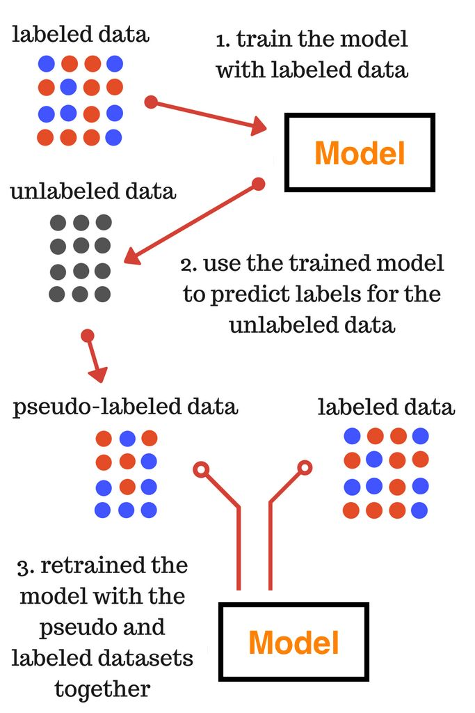
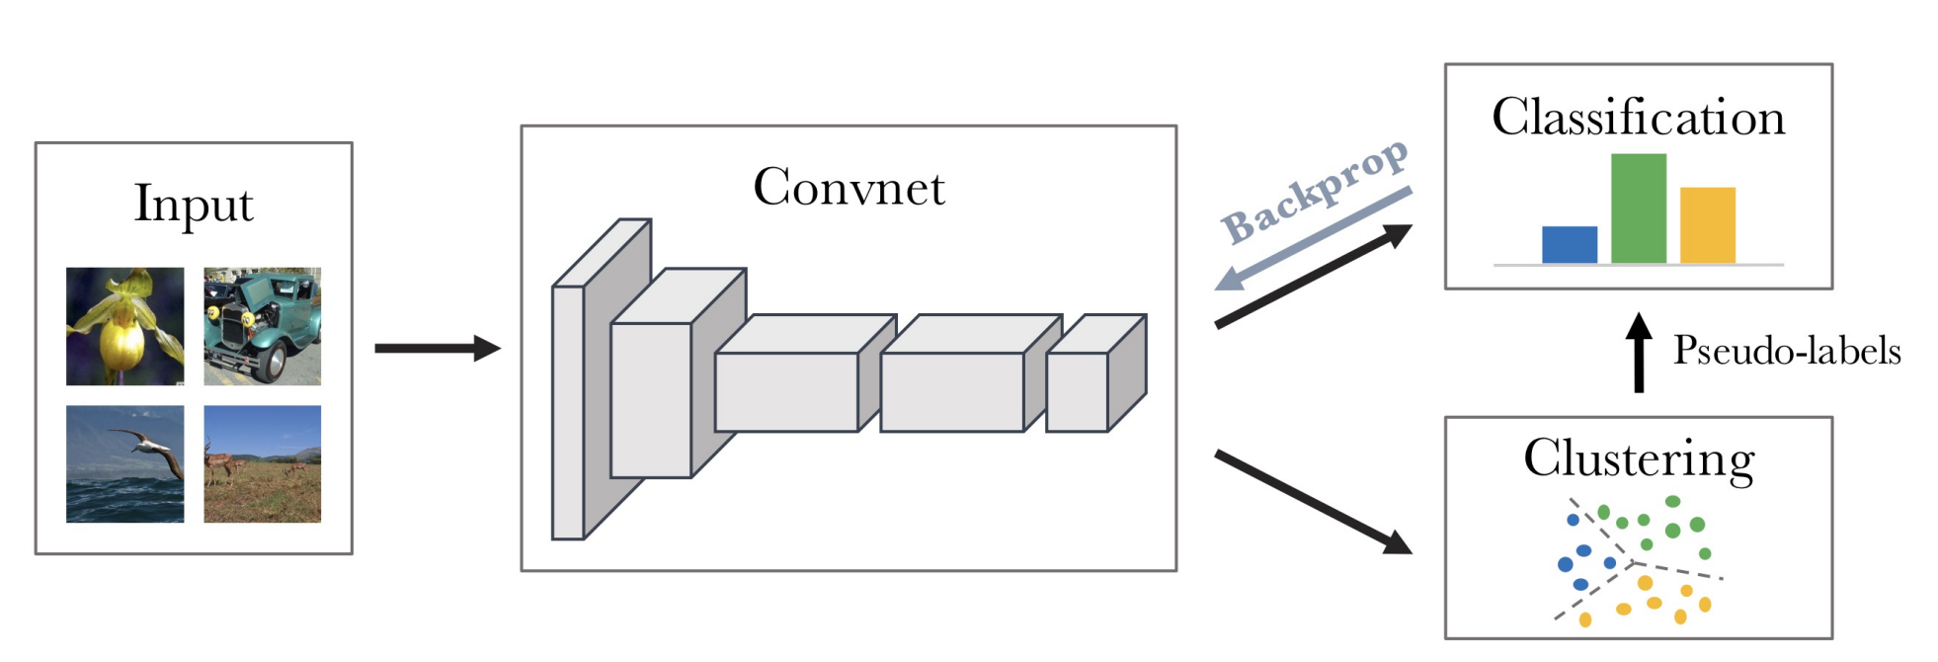
Pseudo Label as target
DeepCluster

Slide 5
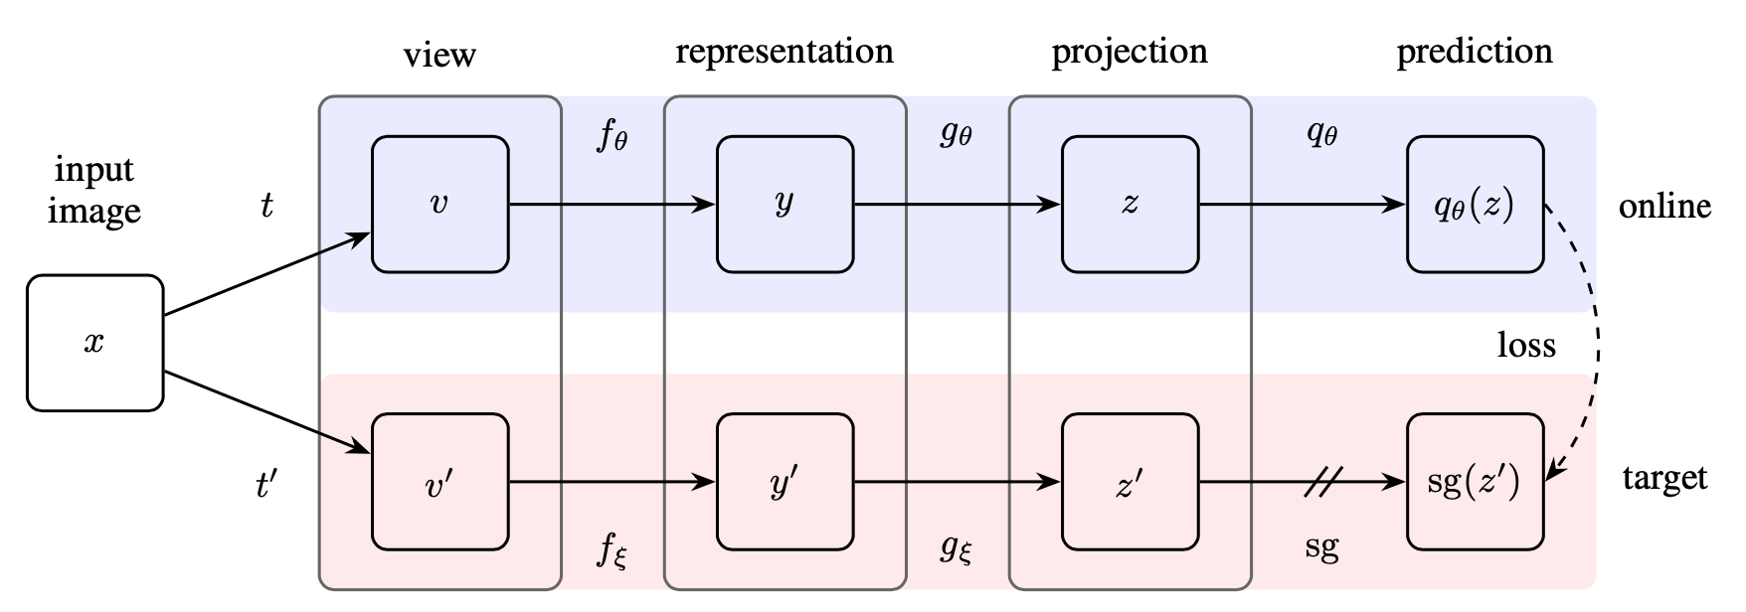
Bootstrap the representations directly

Slide 6
Motivation
v
Network
Projector
t1
x
Prediction?
t2
v’
Network2
Projector2

Slide 7
Motivation
0,0,0
v
Network
Projector
t1
x
Prediction -> Mode collapse
t2
v’
Network2
Projector2
0,0,0

Slide 8
Motivation
v
Network
Projector
t1
x
Prediction?
t2
v’
Network2
Projector2
Randomly initialized. Fixed

Slide 9
Motivation
Linear evaluation protocol on ImageNet
Network
Projector
18.8%
t1
v
x
Prediction?
t2
Network2
Projector2
1.4%
v’
Randomly initialized. Fixed

Slide 10
Motivation
Better representation to learn
v
Network
Projector
t1
x
Prediction?
t2
v’
Fix Mapping
Target representation
For a given target representation, we can train a new potentially enhanced representation.

Slide 11
Method
BP to update params
Better representation to learn
v
Network
Projector
t1
x
Update fixed mapping
Prediction?
t2
v’
Fixed Mapping
Target representation
For a given target representation, we can train a new potentially enhanced representation.

Slide 12
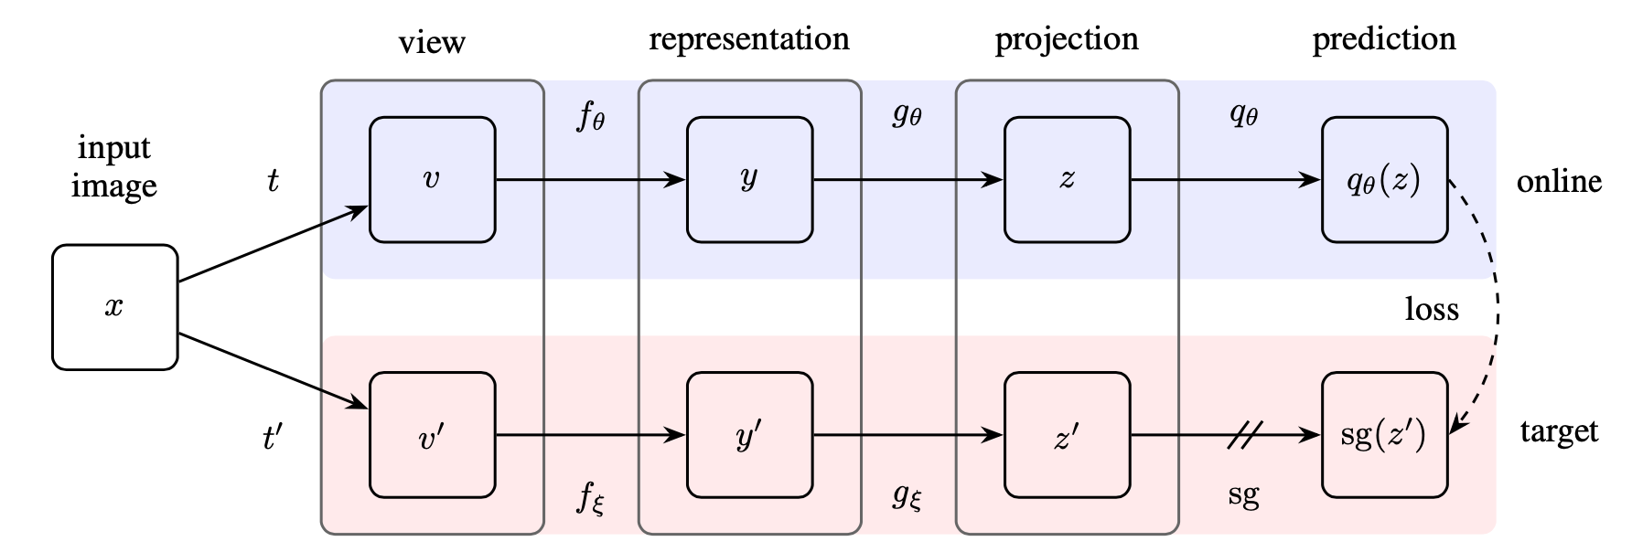
Method
sg: stop gradient
f: encoder, g: projector, q: predictor

Slide 13
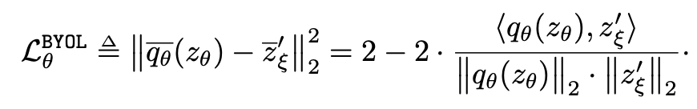


Method
BP to update params
sg: stop gradient
f: encoder, g: projector, q: predictor
Update fixed mapping
Additional component: predictor

Slide 14
Implementation
t: Resize, random horizontal flip, color distortion …
f: ResNet-(50,101,152,200)(1X, 4X
g,q: MLP, Dense+BN+ReLU+Dense
Optimization: LARS optimizer, cosine decay learning rate, τ starts from 0.996 to 1,
batch size 4096, 1000 epochs, 512 Cloud TPU v3, 8h for ResNet-50(1X)

Slide 15
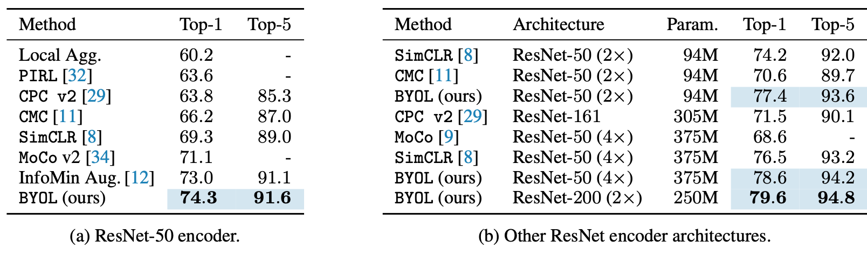
Linear evaluation on ImageNet
ResNet-50 (4X) supervised baseline: 78.9%

Slide 16
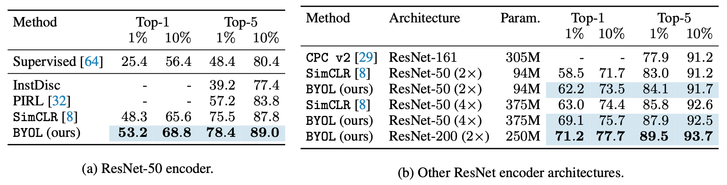
Semi-supervised training on ImageNet

Slide 17
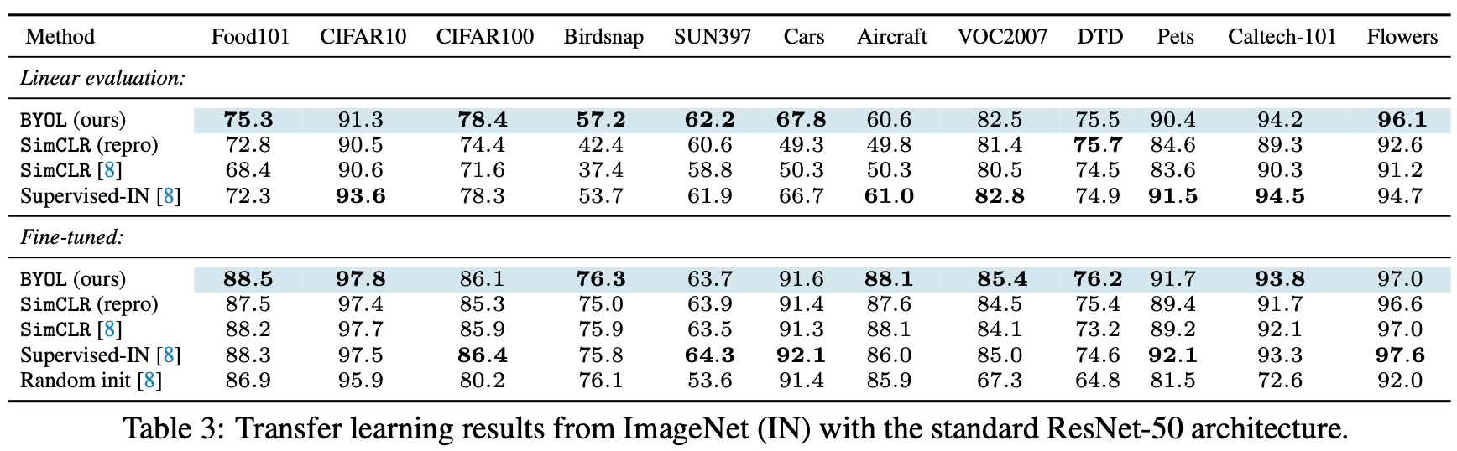
Transfer to other classification tasks

Slide 18
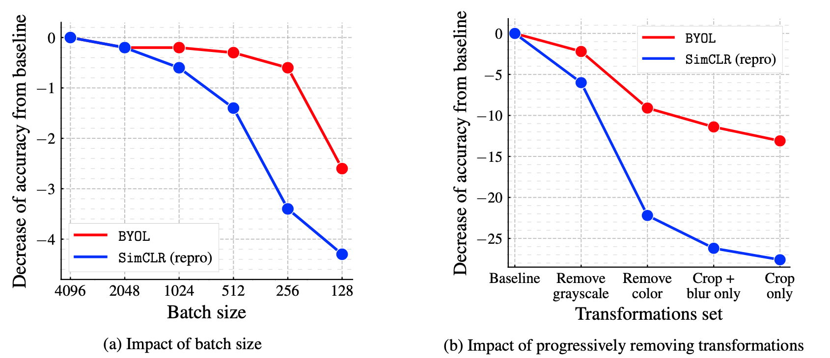
Ablation study

Slide 19
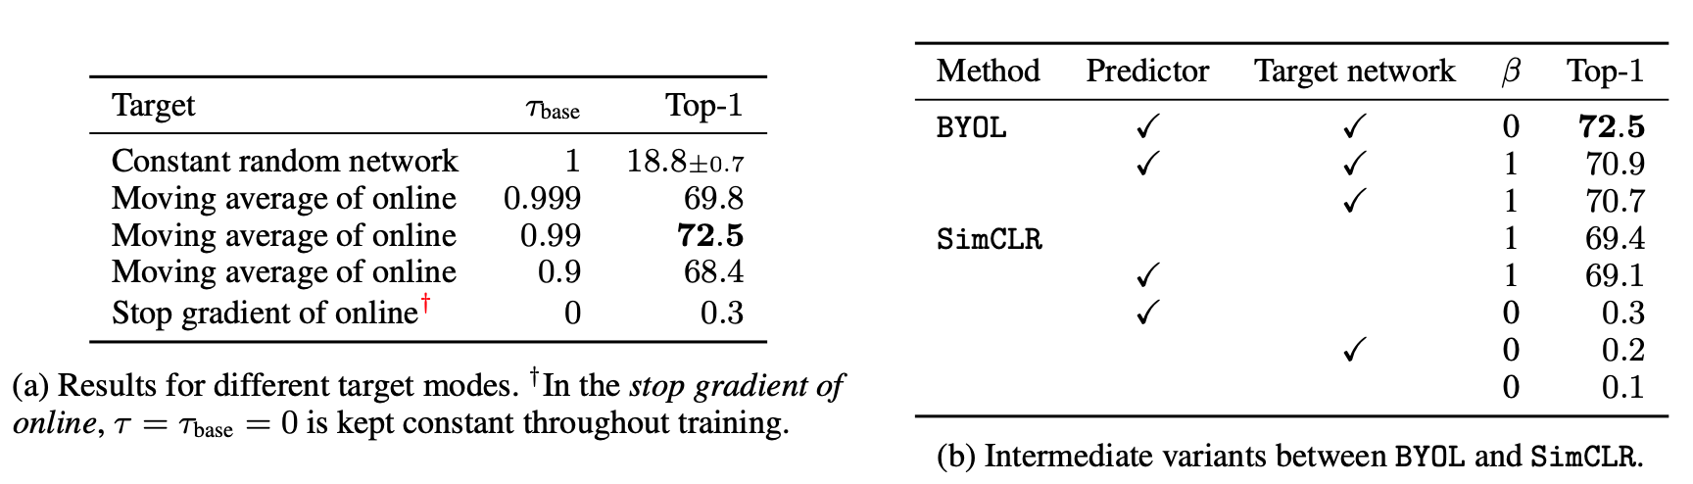
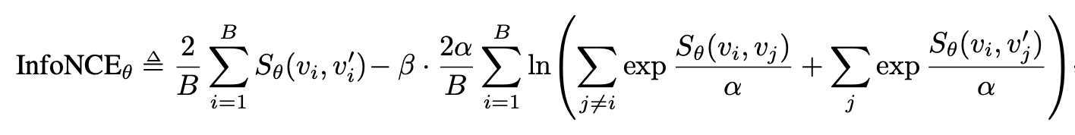

Slide 20
Thanks.
Q&A

